Slide 1

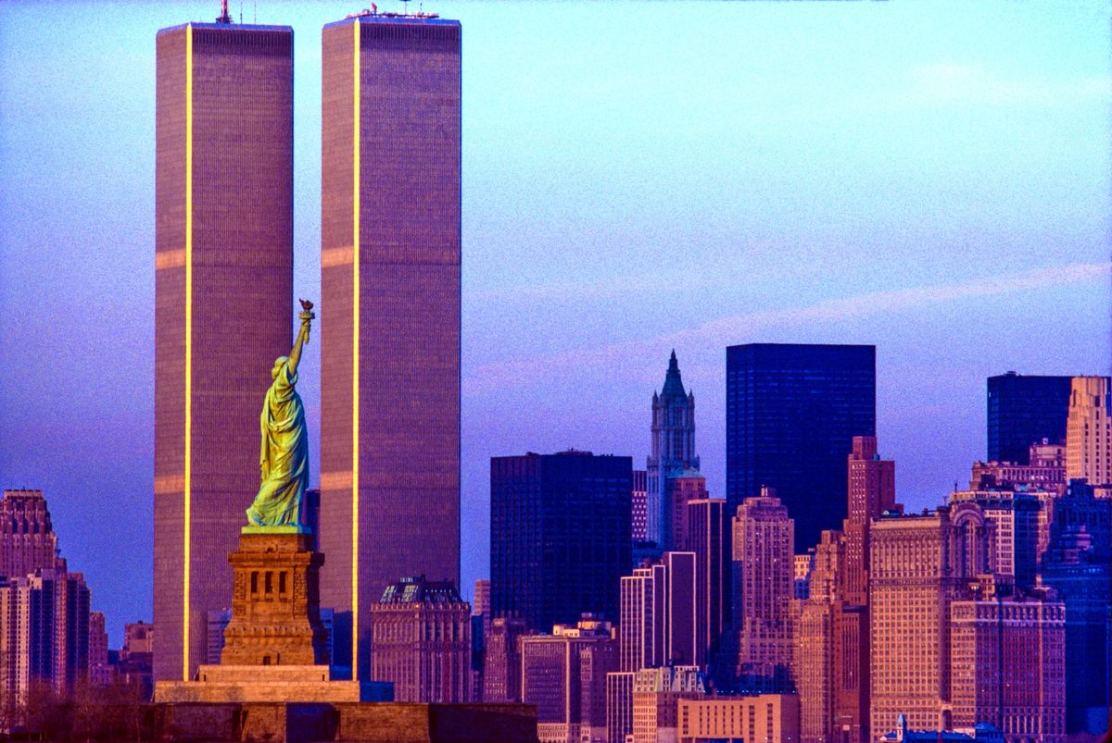

REPORT FOR CE308 WORLD TRADE CENTER
LISHI DODUM (200104053)
NILESH KUMAR (200104069)
PRATEEK PARIHAR (200104080)
SUMIT KUMAR (200104109)
TUSHAR BHAKAT (200104113)
VIVEK SATTAWAN (200104118)
SUBMISSION DATE:10/04/2023

Slide 2



PROJECT OVERVIEW
The original World Trade Center (WTC) was a large complex of seven buildings in the Financial District of Lower Manhattan, New York City.
It opened on April 4, 1973, and was destroyed in 2001 during the attack of 9/11 on Sept 11, 2001.
At the time of their completion, the Twin Towers—the original 1 World Trade Center (the North Tower) at 1,368 feet (417 m); and 2 World Trade Center (the South Tower) at 1,362 feet (415.1 m)—were the tallest building in the world.
The complex contained 13,400,000 square feet (1,240,000 m2 ) of office space and, prior to its completion, was projected to accommodate an estimated 130,000 people. ​

Slide 3
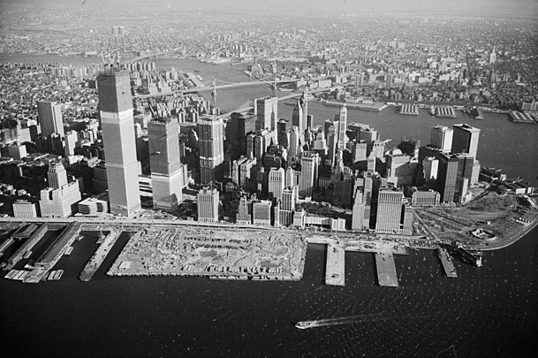


CONTRACT DETAILS
David Rockefeller suggested that the Port Authority would be a logical choice for taking on the project rather than Rockefeller.
The Port Authority formally backed the project on March 11, 1961.
The core complex was built between 1966 and 1975, at a cost of $400 million (equivalent to $3.56 billion in 2022).
In January 1967, the Port Authority awarded $74 million in contracts to various steel suppliers.
The buildings at the complex were designed by Minoru Yamasaki as lead architect and Emery Roth and Sons as associate architects. Tishman Realty and the construction company was the general contractor on the World Trade Center project.

Slide 4

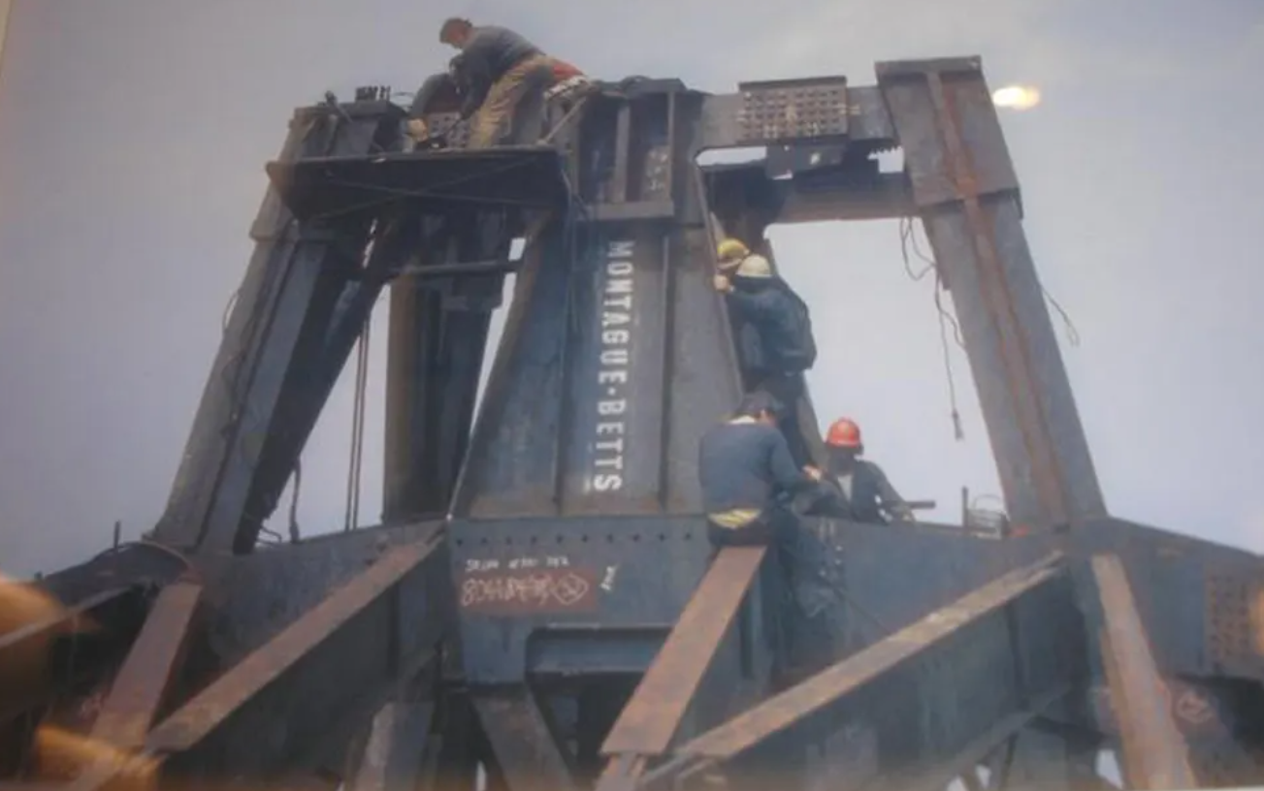

TECHNIQUES ADOPTED
TUBE STRUCTURE: It consisted of a series of closely spaced steel columns and beams that formed a rigid frame. This design allowed the building to withstand high winds and seismic activity.
HIGH-STRENGTH STEEL: The steel used in the construction of the World Trade Center was of high strength, which allowed for thinner columns and beams.
SLURRY WALL CONSTRUCTION: A slurry wall was constructed around the perimeter of the site to prevent water from seeping into the foundation.
PREFABRICATION: Many of the building components were prefabricated off-site and then transported to the construction site. This technique was used for the towers' steel columns and trusses, which were fabricated off-site and then lifted onsite.
SLIP FORMING: It is a continuous method of pouring concrete to form a structure. This technique was used in the construction of the towers' cores, which were poured continuously for several weeks.
Sprayed-fire-resistant materials (SFRMs) were used to protect some structural steel elements in the towers, including all floor trusses and beams.
To erect the tallest building in the world, "kangaroo cranes" were brought over from Australia.
Click to add photo

Slide 5
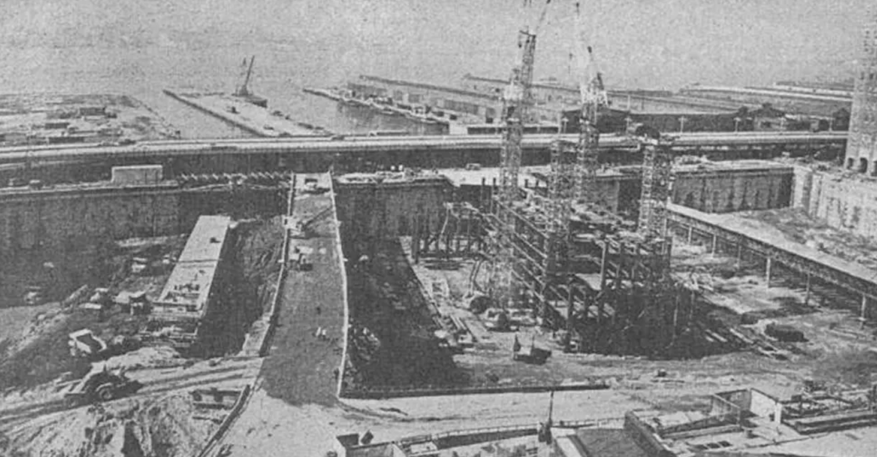

EQUIPMENTS USED
EQUIPMENT USED

Slide 6

Earthmoving equipment
BULLDOZERS
EXCAVATORS
BACKHOE LOADER (JCB)
LOADERS
GRADERS

Slide 7
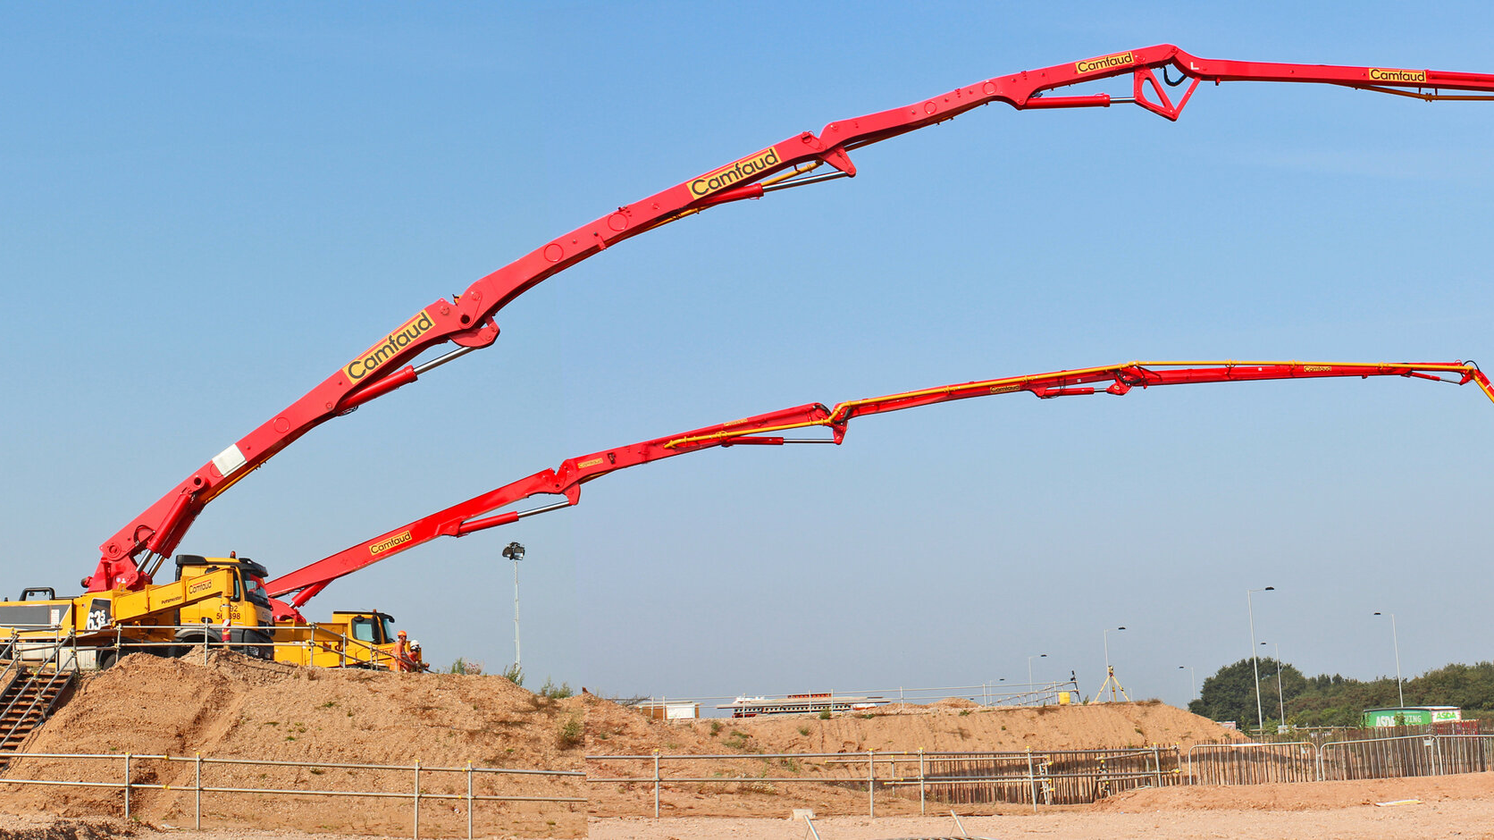
CONCRETE PUMP

Slide 8
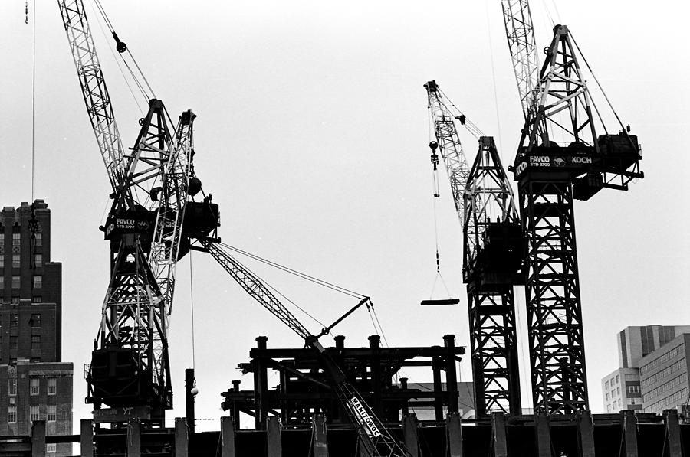
Cranes
LIFTING AND MOVING HEAVY MATERIALS
EFFICIENT AND SAFE
SUPPORTING WORKERS
DURING CONSTRUCTION

Slide 9
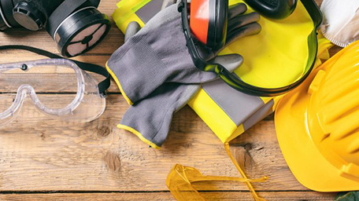
SAFETY TOOLS
HARD HATS
SAFETY HARNESSES
SAFETY NET
SAFETY BARRIERS
EMERGENCY COMMUNICATION SYSTEM

Slide 10
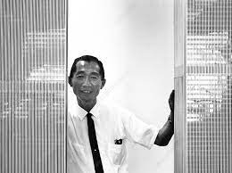
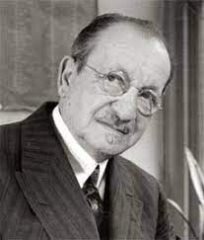
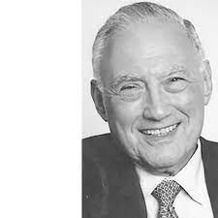
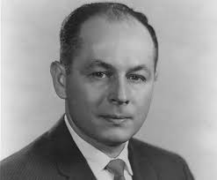
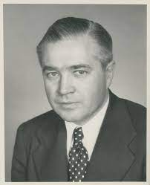
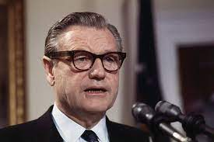
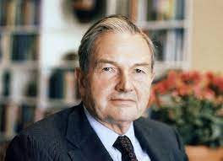
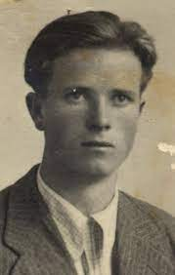
WHO MADE THE GIGANTIC WTC POSSIBLE?
MINORU YAMASAKI
Emiry roth
JOSEPH L LORING​
GUY F TOZZOLI​
Lead Architect
Associate Architect
Electric Engineer
Director of WTC at Port Authority
AUSTIN TOBIN
NELSON ROCKEFELLER
DAVID ROCKEFELLER
MONTI RINO
Port Authority Director
NYC Governor,1961
Port Authority was Suggested by him
Chief Engineer

Slide 11
PROJECT DISPUTES
1
Cost Overruns:
4
Environmental Concerns:
The initial budget for the WTC was $350 million, but the final cost exceeded $1 billion.
The excavation of the site released large amounts of pollutants into the air and nearby waterways.
2
Design Changes:
5
Controversial Construction of WTC
The original design for the WTC included a lattice-like facade that was later changed to a smooth glass exterior.
Its site was the location of Radio Row, home to hundreds of commercial and industrial tenants, property owners, small businesses, and approximately 100 residents, many of whom fiercely resisted forced relocation
3
Labor Disputes:
The construction of the WTC was plagued by labor disputes, with workers demanding better pay and working conditions.

Slide 12
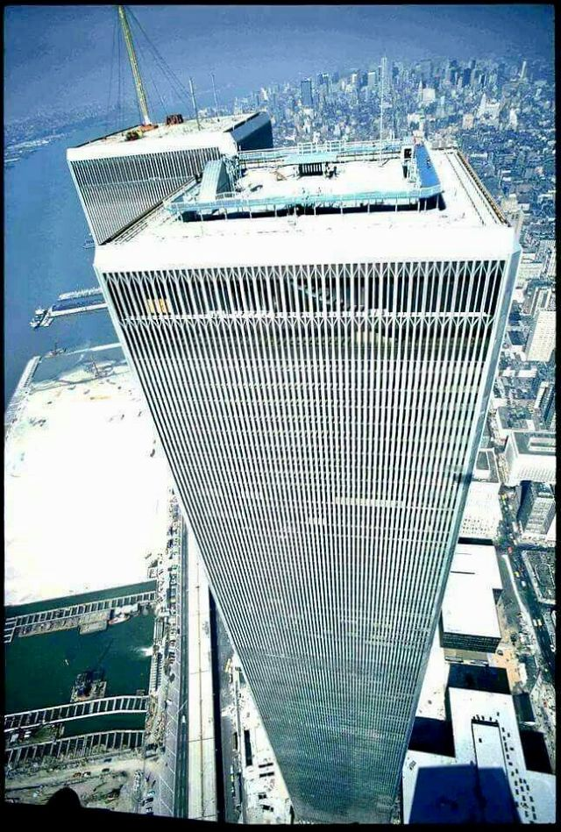
PROJECT DISPUTES
Aesthetics Criticism:
6
Many disliked the twin towers' narrow office windows, which were only 18 inches (46 cm) wide and framed by pillars that restricted views on each side to narrow slots.
7
Suicide Concerns:
To counter that issue an anti-suicide fence was placed on the roof itself.
Delay at the beginning of construction:
8
The idea of establishing a World Trade Center in New York City was first proposed in 1943 But started in 1968.

Slide 13
IMPLEMENTATION OF ICT AND AUTOMATION
CAD
The design of the World Trade Center towers was done
ELEVATOR AUTOMATION
This allowed for efficient and speedy movement of people and materials throughout the
COMMUNICATION SYSTEMS
Advanced
MATERIAL HANDLING
KANGAROO CRANES
Use of cranes and other
Equipped
using CAD technology,
buildings.
communication system that included intercoms, public address systems, and emergency
call buttons.
heavy equipment to move materials and equipment.
with automation technology, which allowed for more precise movements and improved
safety.

Slide 14
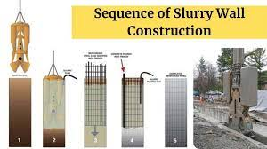
CHALLENGES FACED AND THE PROBABLE STRATEGIES
CHALLENGE 1: ​
STRATEGY:​
WTC had been built upon generations of landfill.
To reach a solid base of bedrock, workers had to dig down 70 feet (21.3 meters).
The excavated section of the city was to be protected from filling with water as fast as the earth was removed because of the proximity of the river.
The slurry trench method.

Slide 15
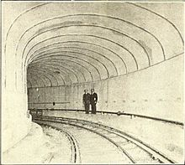
CHALLENGES FACED AND THE PROBABLE STRATEGIES
CHALLENGE 2:
STRATEGY:
The PATH commuter rail line ran directly through the center of the construction site.
Instead of interrupting service, engineers designed a protective cradle for the underground line and as a result, the train ran throughout the entire project, carrying 130,000 passengers a day.

Slide 16
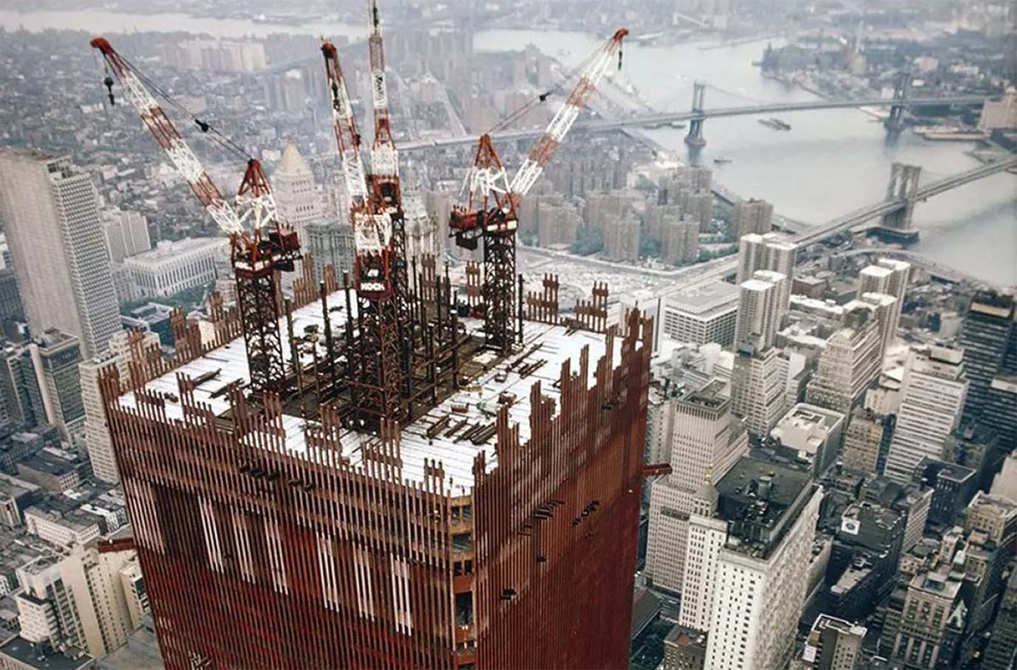

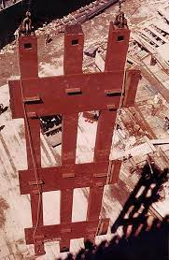

PROJECT PERFORMANCES
DURATION
In March 1965, the Port Authority began acquiring property at the World Trade Center site.
The 47-story 7 World Trade Center building was added in the 1980s, to the north of the main complex.
The WTC 1 took 11 years to complete.
SAFETY
The major structural material employed in the towers was A36 structural steel
The composite slabs were made of 21MPa (3ksi) lightweight concrete.
The interior face of each column was fire protected with an approximately 5cm thick layer of vermiculate plaster.
Fire-rated suspended ceiling.

Slide 17
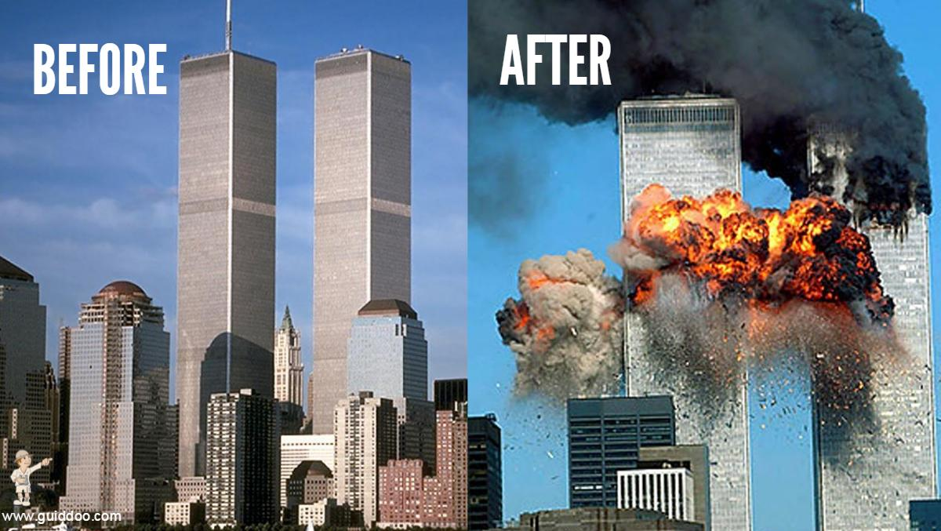

CONCLUSION
Overall, the construction of the World Trade Center was a complex project that involved numerous parties and led to several disputes. Despite these challenges, the WTC was completed and became an iconic symbol of New York City until the tragic events of September 11, 2001.

Slide 18

Santu Kar Sir

